Slide 1
Comcast Trove Design Proposal (draft)

Slide 2
0.96 PB Ceph + 2.1 PB Swift backup* (2 Racks)
High Level Network Architecture Diagram
2x 56G ISL
Customer Up-Links
1 Gb
10 Gb
2x1G
OpenStack Controller
(OpenStack services & Ceph monitor)
2x10G
10 Gb
OpenStack Controller
(OpenStack services & Ceph monitor)
OpenStack Controller
(OpenStack Svcs & Ceph monitor + Op Mgmt)
**
OpenStack Compute
Trove VM
OpenStack Compute
Trove VM
OpenStack Compute
Trove VM
OpenStack Compute
Trove VM
Per Server Node
2x10G DAC Cables
2x 1G Cat5e Cables
Swift Proxy
**
Swift Object
Swift Object
Swift Object
**
Swift Metadata
** Possible Configure 2x40G per node for Controller, Proxy & Object
OS provisioning
Ceph block
(OSD)
IPMI
Ceph block
(OSD)
Ceph block
(OSD)
Data
Ceph block
(OSD)
Mellanox 8891-S52, Qty 2
One Per Rack
Mellanox SX1410, Qty 2

Slide 3
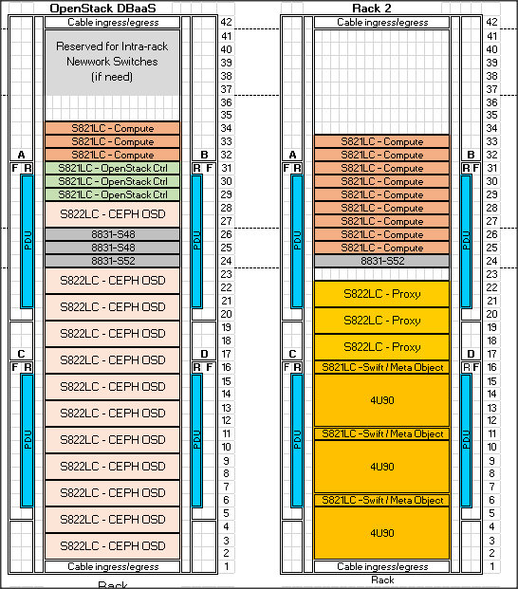
Racking / Config
Network Option 1: (HA)
2 x Mellanox SX1410 (8831-S48)
1*x Mellanox (8891-S52) (* per rack)
Rack:
QTY: 2
SlimRack 7965-94Y
PDUs
Network Option 2: (non HA)
1 x Mellanox SX1410 (8831-S48)
2* x Mellanox (8891-S52) (* per rack)
OpenStack Controller:
QTY: 3
Server Config: (Stratton 8001-12C)
16 Cores ( 2.3Ghz), 128GB ,
2 x 4TB Sata HDDs
2 x 2-Port 10G NIC ( Intel 10G/Mellanox)
See Notes: **
Swift Proxy:
QTY: 3
Server Config: (Stratton 8001-12C) (1U)
20 Cores ( 2.922Ghz), 256GB ,
2 x 4TB Sata HDDs
2 x 2-Port 10G NIC ( Intel 10G/Mellanox)
OpenStack Compute:
QTY: 12
Server Config: (Stratton 8001-12C) (1U)
16 Cores ( 2.3Ghz), 128GB ,
2 x 4TB Sata HDDs
2 x 2-Port 10G NIC ( Intel 10G/Mellanox)
Swift Object /MetaData
QTY: 3
Per Server Config: (Briggs 8001-21C) (2U)
20 Cores ( 2.0Ghz), 256GB ,
(OS) 2+ 128GB DOM + (Meta) 2/4 x NvMe 800GB (cache) (3 & 5 DWPD or SSDs
2 x 2-Port 10G NIC ( Intel/Mellanox)
Expansion Drawer (4U)
90 LFF – 8TB SATA HDDs
CEPH Config :
QTY: 12
Per Server Config: (Briggs 8001-22C) (2U)
20 Cores ( 2.92Ghz), 256GB ,
(OS) 2+ 128GB DOM + (Meta) 2x SSD 800GB (cache) (1.2 DWPD) + (Storage)10 x 8TB HDDs (~80TB)
2 x 2-Port 10G NIC ( Intel/Mellanox)
**Notes:
Openstack & Proxy Node can be combined (if requires lesser than 24 SWIFT Objects)
Compute qty + Memory config change is required base on actual Database Performance requirement
Dedicated Swift Meta Data Server maybe required

